Slide 1

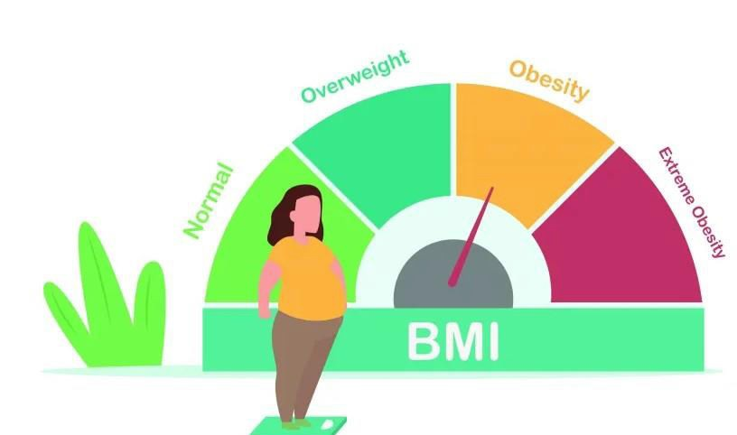
Body Mass Index Calculator
DHAMINI SAHU

Slide 2

Goal and Overview of the
Implementation of the GUI using JFrame
The Goal is to develop a Graphical User Interface (GUI) using a Java Swing and JFrame implementation of a Body Mass Index (BMI) calculator application.
The code initially creates a JFrame object and defines its dimensions, background color, and layout. The user input fields and labels for entering their weight and height are then added as several JLabels and JTextFields to the frame.
The "Calculate" button, an instance of the JButton class with an ActionListener connected to it, is also added to the frame. When the button is pressed, the ActionListener analyzes the user- entered weight and height values before using the BMI calculation to determine the BMI value.
Another JLabel is then used to display the BMI value on the frame. In addition, the code adds a "Clear" button to the frame that, when pressed, clears the input fields and the result label.
In summary, the code uses JFrame to develop a simple BMI calculator application that accepts user input, conducts calculations, and shows the results on the screen.

Slide 3
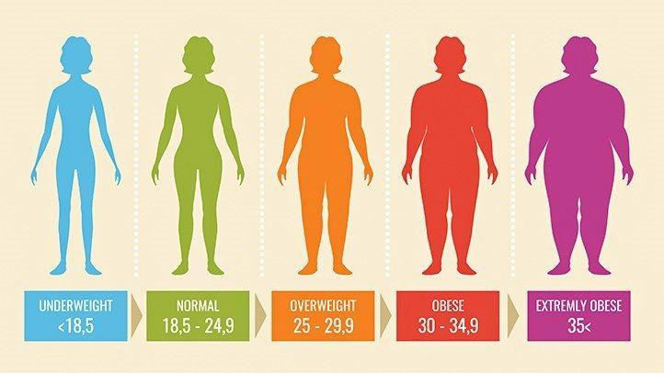
Why BMI Calculator?
The Body Mass Index (BMI) calculator is a valuable tool for keeping track of one's health and fitness. Body mass index (BMI) is a measurement of body fat based on height and weight. The higher the BMI, the greater the likelihood of having health issues such as heart disease, diabetes, and high blood pressure. As a result, it is critical to maintain a healthy BMI to limit the risk of various health conditions.
The importance of having a BMI calculator tool cannot be emphasized. First and foremost, it assists people in keeping track of their weight and staying healthy. Individuals can identify whether they are underweight, normal weight, overweight, or obese by assessing their BMI .

Slide 4
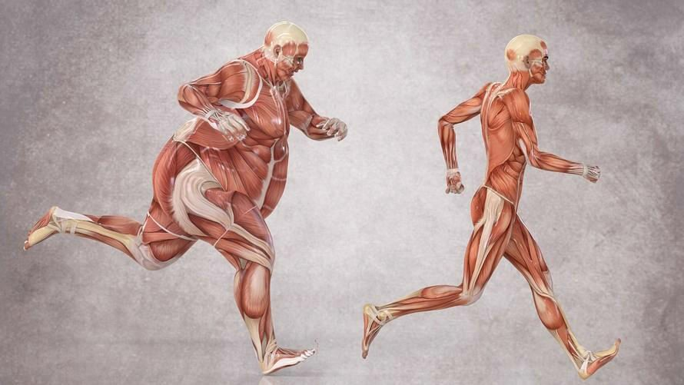
Advantages of BMI Calculator
The JFrame-based BMI calculator can be beneficial in real-world settings for both individuals and healthcare professionals.
For individuals, the calculator provides an easy and quick way to determine their BMI and get an idea of their overall health status. This can be particularly useful for those looking to lose weight or make lifestyle changes to improve their health.
The BMI calculator may be a useful tool for healthcare providers in measuring a patient's health state and tracking their development over time. It can also aid in the identification of people at risk for obesity-related health disorders such as diabetes, heart disease, and high blood pressure.
Overall, the BMI calculator project utilizing JFrame gives a simple and effective approach to compute BMI, which may be a helpful tool for both individuals and healthcare professionals.
–
–

Slide 5
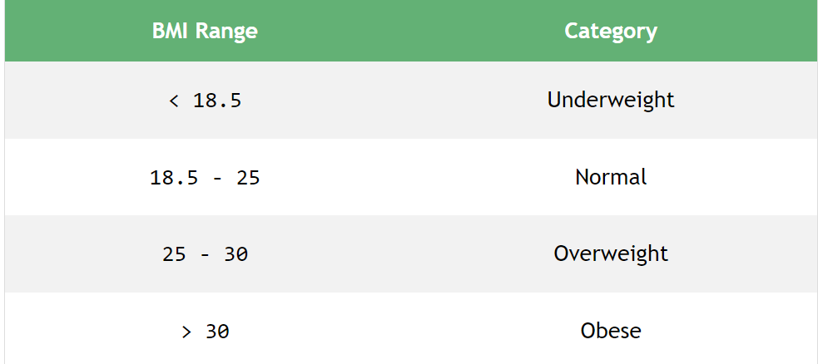
Let's have a look at the formula for calculating BMI:
BMI = Weight in Kilograms / (Height in Meters * Height in Meters)
A person's categorized as Underweight, Normal, Overweight, or Obese based on the BMI range: In the shown picture.
For example, let's calculate the BMI of an individual with a weight equal to 100kg (Kilograms) and a height equal to 1.524m (Meters).
BMI = 100 / (1.524 * 1.524)
BMI = 43.056
Since BMI is greater than 30, the person is categorized as “Overweight”.

Slide 6
CODE:
// import necessary packages
import java.awt.Color;
import java.awt.Font;
import java.awt.event.ActionEvent;
import java.awt.event.ActionListener;
import javax.swing.*;
public class BMIcalculator {
public static void main(String[] args) {
// create JFrame and set its properties
JFrame frame = new JFrame("BMI Calculator");
frame.setSize(525, 525); // set size of the frame
frame.setDefaultCloseOperation(JFrame.EXIT_ON_CLOSE); // set default close operation
frame.setLayout(null); // set layout to null for absolute positioning
frame.getContentPane().setBackground(Color.BLACK); // set background color of the content pane

Slide 7
// create and add heading label to the frame
JLabel heading = new JLabel("BMI Calculator");
heading.setBounds(125, 15, 300, 45); // set size and position of the label
heading.setFont(new Font("Times New Roman", Font.BOLD, 24)); // set font of the label
heading.setForeground(Color.WHITE); // set foreground color of the label
frame.add(heading);
// create and add height label and text field to the frame
JLabel heightLabel = new JLabel("Height (in cm):");
heightLabel.setBounds(60, 75, 150, 45); // set size and position of the label
heightLabel.setForeground(Color.WHITE); // set foreground color of the label
frame.add(heightLabel);
JTextField heightTextField = new JTextField();
heightTextField.setBounds(225, 75, 225, 45); // set size and position of the text field
frame.add(heightTextField);
// create and add weight label and text field to the frame
JLabel weightLabel = new JLabel("Weight (in kg):");
weightLabel.setBounds(60, 135, 150, 45); // set size and position of the label

Slide 8
weightLabel.setForeground(Color.WHITE); // set foreground color of the label
frame.add(weightLabel);
JTextField weightTextField = new JTextField();
weightTextField.setBounds(225, 135, 225, 45); // set size and position of the text field
frame.add(weightTextField);
// create and add result label to the frame
JLabel resultLabel = new JLabel();
resultLabel.setBounds(60, 300, 300, 45); // set size and position of the label
resultLabel.setForeground(Color.WHITE); // set foreground color of the label
resultLabel.setFont(new Font("Times New Roman", Font.BOLD, 21)); // set font of the label
frame.add(resultLabel);
// create and add calculate button to the frame
JButton calculateButton = new JButton("Calculate");
calculateButton.setBounds(225, 210, 150, 45); // set size and position of the button
calculateButton.addActionListener(new ActionListener() {
public void actionPerformed(ActionEvent e) {
try {
// get height and weight values from text fields and calculate BMI
double height = Double.parseDouble(heightTextField.getText());
double weight = Double.parseDouble(weightTextField.getText());
double bmi = weight / ((height / 100) * (height / 100));

Slide 9
// format and display the result in the result label
String result = String.format("Your Body Mass Index: %.2f", bmi);
resultLabel.setText(result);
resultLabel.setForeground(Color.WHITE); // set foreground color of the label
} catch (NumberFormatException ex) {
// display error message if invalid values are entered
resultLabel.setText("Please enter valid values");
}
}
});
frame.add(calculateButton);
// create and add clear button to the frame
JButton clearButton = new JButton("Clear");
clearButton.setBounds(60, 210, 150, 45);
clearButton.addActionListener(new ActionListener() {
public void actionPerformed(ActionEvent e) {
heightTextField.setText("");
weightTextField.setText("");
resultLabel.setText("");
}
});
frame.add(clearButton);
frame.setVisible(true);
}
}

Slide 10
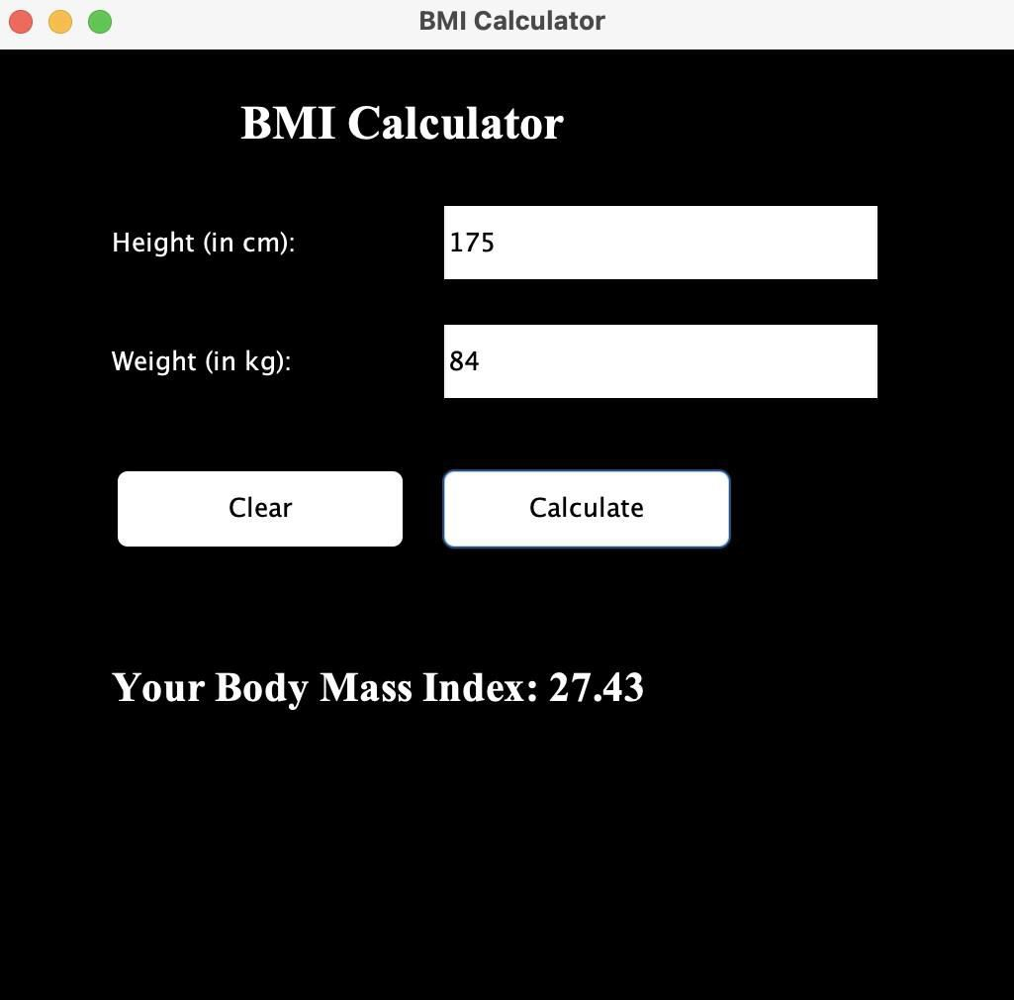
Expected Output:
A body Mass Index GUI Calculator

